Slide 1
Design Pattern : Strategy Ruchita Amale

Slide 2
1) Creational patterns provide object creation mechanisms that increase flexibility and reuse of existing code. 2) Structural patterns explain how to assemble objects and classes into larger structures, while keeping these structures flexible and efficient. 3) Behavioral patterns take care of effective communication and the assignment of responsibilities between objects.
Introduction : Design Patterns
Design Patterns : typical solutions to commonly occurring problems in software design.

Slide 3
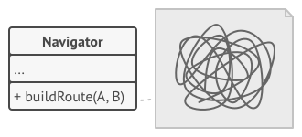
WHAT IS A STRATEGY ?
A Strategy is a behavioral design pattern that defines a family of algorithms, puts each in a separate class, and makes them interchangeable.
Enables choosing the algorithm at runtime.
Purpose:
Simplifies code maintenance by decoupling algorithm logic from the core system.
Problem:
Build Route Service for Travellers
+ buildRoute( ) for Cycle
+ buildRoute( ) for Bike + buildRoute( ) for Car + buildRoute( ) for Walking

Slide 4
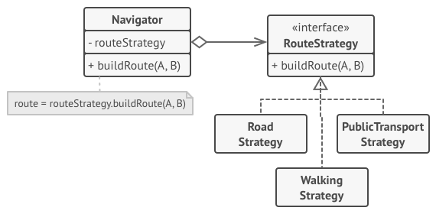
Strategy Pattern: Solution
WHAT IT SUGGESTS
Separate the algorithms (strategies) into their own classes.
The context class delegates the task to the strategy class instead of implementing the logic itself.
Clients pass the strategy to the context, and it triggers the algorithm through a generic interface.

Slide 5
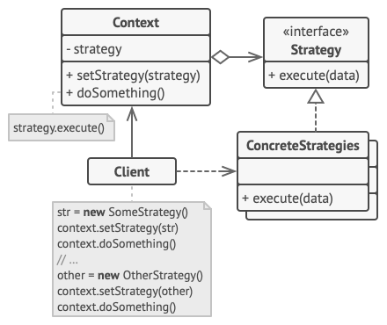
Structure of the Strategy Pattern
CORE CONCEPTS
Context Class: Holds a reference to a strategy. Calls the strategy without knowing its details.
Strategy Interface: Common method for all strategies to implement.
Concrete Strategies: Implement specific algorithm variations.
Client: Pass the strategy to the context, and it triggers the algorithm through a generic interface.

Slide 6
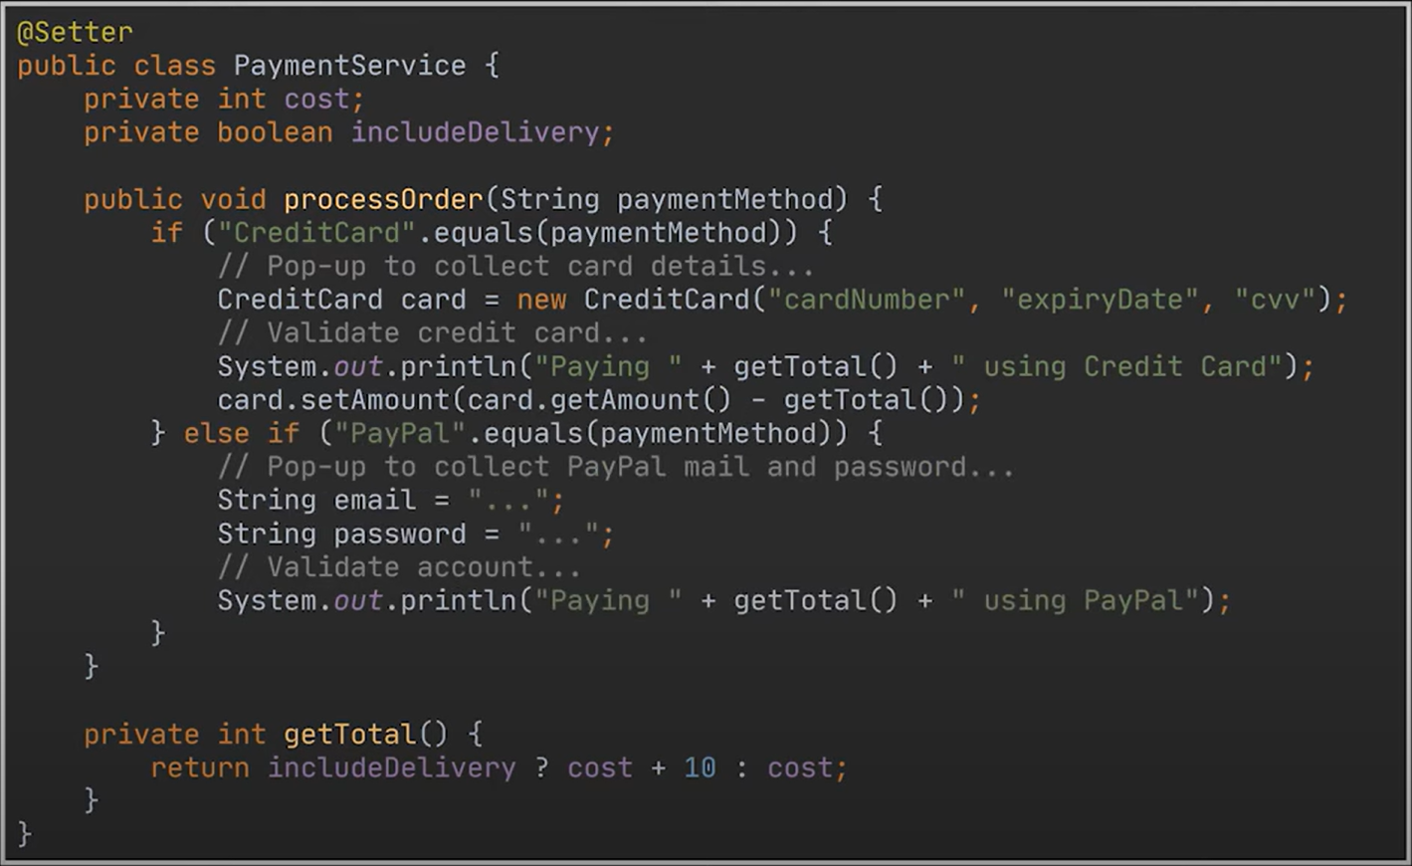
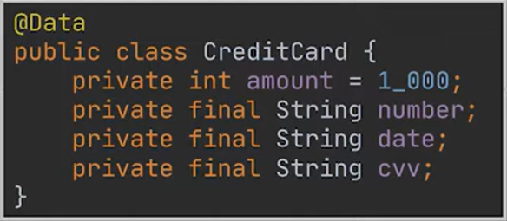
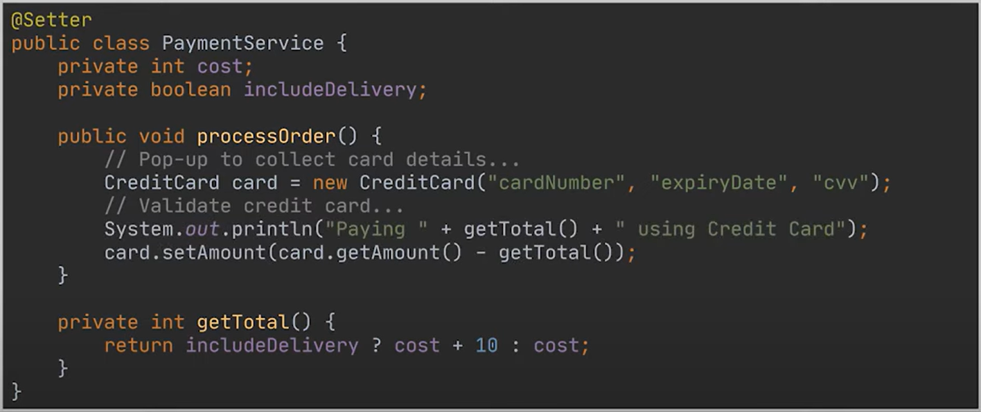
Problem : Payment Processing
# Violation of - Open / Closed Principle - Single Responsibility Principle

Slide 7
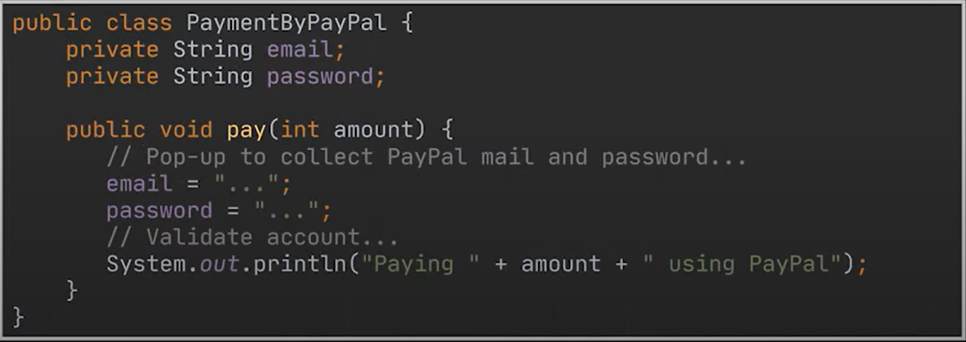
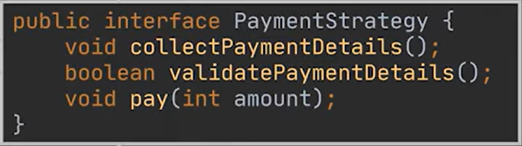
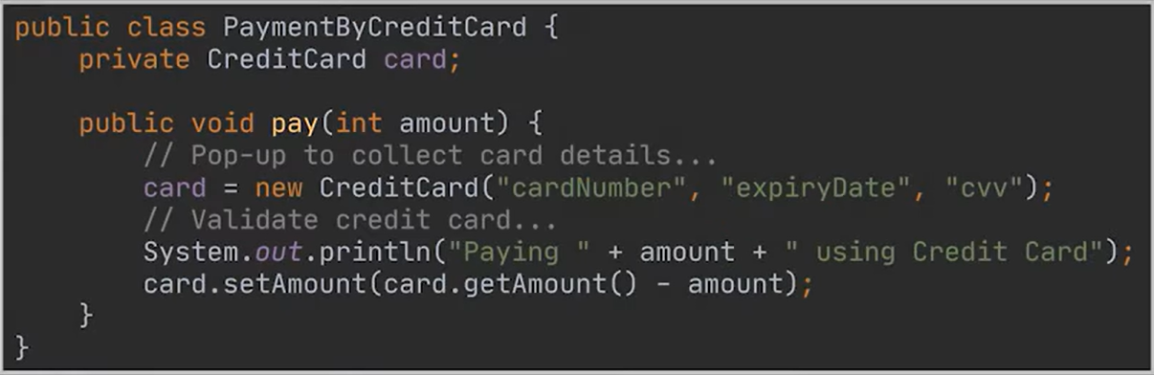
Solution : Using Interface

Slide 8
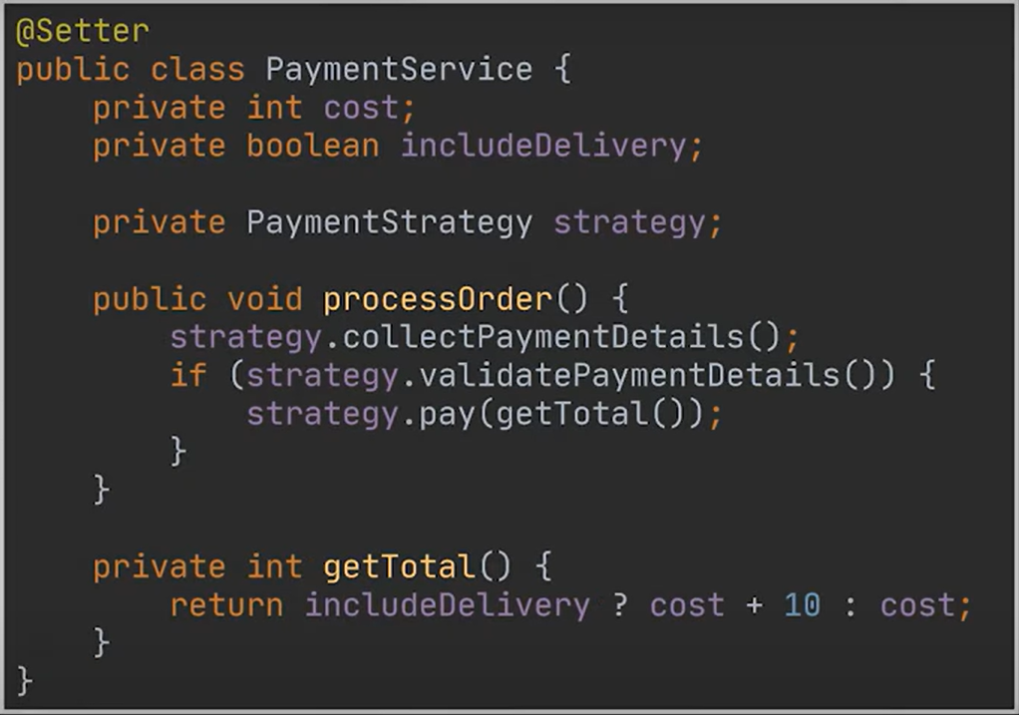
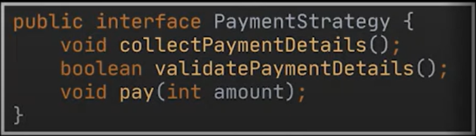
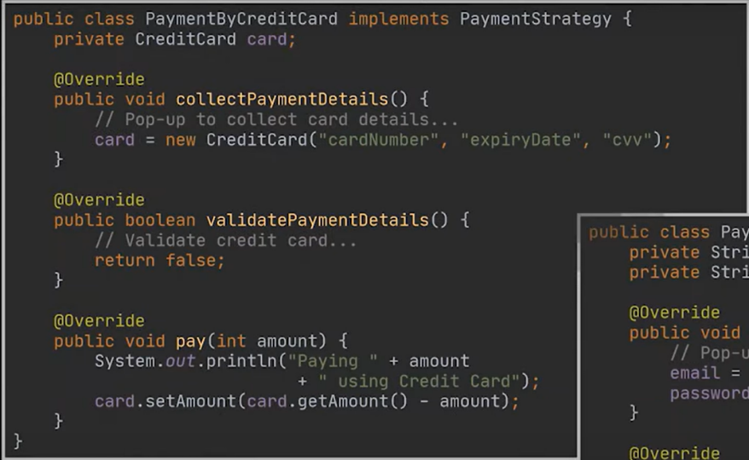
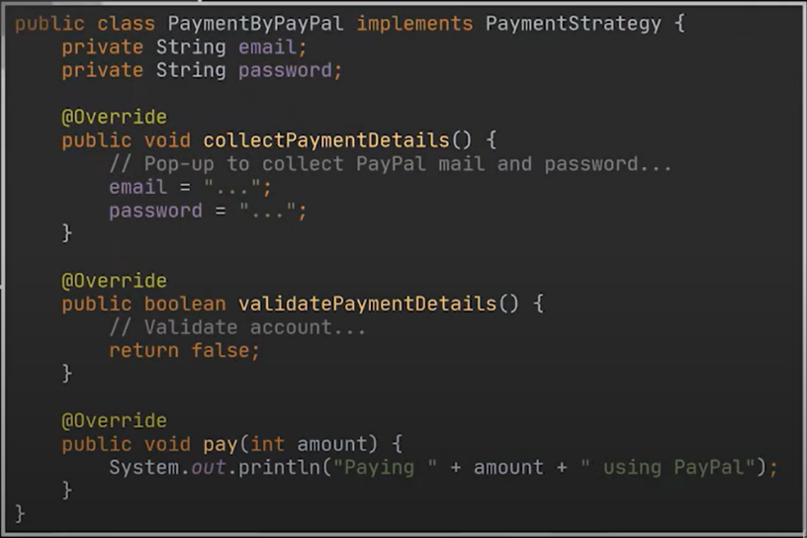
Service
Interface
Classes Implementing Interface
Entity

Slide 9
Pros And Cons of Using Strategy
Pros:
Can swap algorithms at runtime.
Reduces code duplication.
Increases maintainability and flexibility.
Promotes adherence to the Open/Closed Principle.
Cons:
Adds complexity (requires additional classes).
Clients must be aware of strategy differences.

Slide 10
When to Use
When there are multiple algorithms that can be used in a similar way.
When switching algorithms at runtime is required.
When you want to avoid complex conditional statements (e.g., if-else chains).
Example: Algorithms for different route planning strategies (Car, Walking, etc.).
When Not to Use
There are only a few algorithms and they do not change often.
The problem can be solved with simple conditionals or by switching between algorithms manually.

Slide 11
Summary
The Strategy pattern allows for flexible algorithm selection and modification at runtime.
Key Benefits: Maintainability, flexibility, and reducing code bloat.
Use Cases: When multiple algorithms can perform the same task and need to be interchangeable.
Alternatives: Command, Template Method, State patterns.

Slide 12




THANK YOU
(844) 720-6678
info@simplifyhealthcare.com
simplifyhealthcare.com
Simplify Healthcare
U.S.: 600 N Commons Drive, Suite 110, Aurora, IL 60504
India: 401/402, 4th Floor, Pentagon P-2, Magarpatta City, Pune 411013
CONNECT WITH US
LinkedIn
YouTube
X
Instagram

